Slide 1

Mini project 1
Topic - Bricks Transportation Management System

Slide 2

A PROJECT REPORT ON
“Bricks Transportation Management System ”
SUBMITTED BY:
Yash Kishor Bawche
PRN:- 2124UCEM1051
Subject:-
Programming and problem solving using c++
Under the guidance of
Miss. Ishwari Tirse
Department of Computer Science and Engineering
Sanjivani Rural Education Society’s
SANJIVANI UNIVERSITY
KOPARGAON – 423603, DIST : AHMEDNAGAR
2024-2025

Slide 3
INDEX
SR NO. | CONTENT | PAGE NO.
1 | INTRODUCTION | 4
2 | CODE | 6
3 | OUTPUT | 9
4 | CONCLUSION | 11

Slide 4

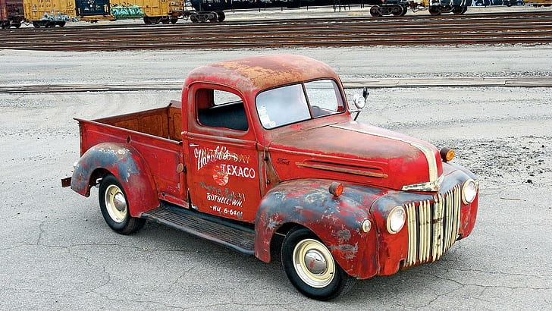
BRICKS TRANSPORTATION MANAGEMENT
INTRODUCTION
A Brick Transportation Management System is a software application designed to facilitate and optimize the logistics involved in the transportation of bricks from suppliers to construction sites. This system automates the processes of order management, tracking deliveries, managing vehicle logistics, and maintaining customer interactions. It enables businesses to efficiently handle brick inventory, track transportation statuses, and streamline communication between suppliers, customers, and transporters. Key features of a Brick Transportation Management System include Order Management, Vehicle Tracking, Customer Management, Inventory Management, and Reporting.

Slide 5
Why Cpp Used ?
C++ is an ideal choice for developing a Brick Transportation Management System due to its performance efficiency, object-oriented programming capabilities, and widespread use in systems programming. The language allows for the creation of robust and high-performance applications, making it suitable for managing complex logistics operations where real-time processing is crucial.
The advantages of a C++-based Brick Transportation Management System include high performance, effective memory management, portability across different platforms, and the ability to handle large datasets. The system can be easily scaled and customized to meet the evolving needs of the transportation business, ensuring optimal performance and reliability in managing brick logistics.

Slide 6
Code
#include <iostream>
#include <vector>
#include <string>
using namespace std;
class Order {
private:
string customer Name, address, vehicle Number, delivery Status;
int bricks Quantity;
double price PerBrick;
public:
Order(string name, string add, int qty, double price, string vehicle)
: customer Name(name), address(add), bricks Quantity(qty),
price Per Brick(price), vehicle Number(vehicle), delivery Status("Pending") {}
void update Status(string status) {
delivery Status = status;
}
void display Order() const {
cout << "Customer: " << customerName << "\nAddress: " << address
<< "\nBricks: " << bricksQuantity << "\nTotal: Rs "
<< bricks Quantity * pricePer Brick << "\nVehicle: " << vehicle Number
<< "\nStatus: " << delivery Status << endl;
}
string getCustomerName() const { return customerName; }
string getVehicleNumber() const { return vehicleNumber; }
};
class BrickTransportSystem {
private:
vector<Order> orders;
double pricePerBrick;
public:
BrickTransportSystem(double price) : pricePerBrick(price) {}
void addOrder() {
string customerName, address, vehicleNumber;
int bricksQuantity;
cout << "Enter customer name: "; cin.ignore(); getline(cin, customerName);
cout << "Enter address: "; getline(cin, address);
cout << "Enter bricks quantity: "; cin >> bricksQuantity;
cout << "Enter vehicle number: "; cin.ignore(); getline(cin, vehicleNumber);

Slide 7
orders.emplace_back(customerName, address, bricksQuantity, pricePerBrick, vehicleNumber);
cout << "Order added successfully.\n";
}
void viewOrders() const {
if (orders.empty()) { cout << "No orders available.\n"; return; }
for (size_t i = 0; i < orders.size(); ++i) {
cout << "\nOrder " << i + 1 << ":\n";
orders[i].displayOrder();
}
}
void updateOrderStatus() {
string customerName, newStatus;
cout << "Enter customer name to update status: "; cin.ignore(); getline(cin, customerName);
for (auto &order : orders) {
if (order.getCustomerName() == customerName) {
cout << "Enter new status (Delivered/On the way/Pending): ";
getline(cin, newStatus);
order.updateStatus(newStatus);
cout << "Order status updated.\n";
return;
}
}
cout << "Order not found.\n";
}
void trackOrder() const {
string vehicleNumber;
cout << "Enter vehicle number to track: "; cin.ignore(); getline(cin, vehicleNumber);
for (const auto &order : orders) {
if (order.getVehicleNumber() == vehicleNumber) {
order.displayOrder();
return;
}
}
cout << "No order found for the vehicle number: " << vehicleNumber << endl;
}
};
int main() {
BrickTransportSystem system(9.0); // Price per brick: Rs 9
int choice;
do {
cout << "\n--- Brick Transportation Management System ---\n";
cout << "1. Add New Order\n2. View All Orders\n3. Update Order Status\n4. Track Order\n5. Exit\nChoose an option: ";
cin >> choice;

Slide 8
switch (choice) {
case 1: system.addOrder(); break;
case 2: system.viewOrders(); break;
case 3: system.updateOrderStatus(); break;
case 4: system.trackOrder(); break;
case 5: cout << "Exiting system.\n"; break;
default: cout << "Invalid choice! Try again.\n";
}
} while (choice != 5);
return 0;
}

Slide 9
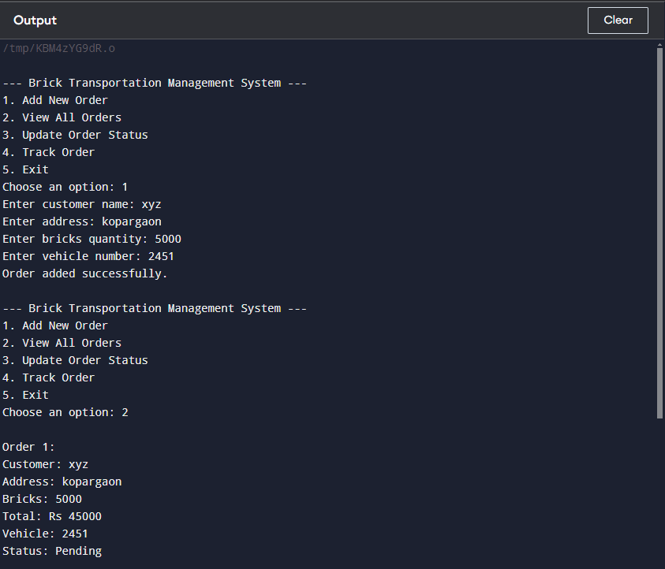
OUTPUT

Slide 10
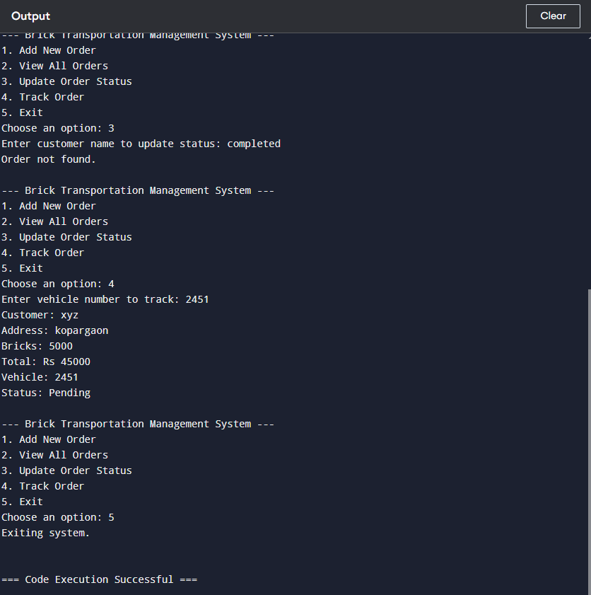

Slide 11
Conclusion
The Brick Transportation Management System developed using C++ provides an efficient solution for managing brick transportation logistics. It automates key processes such as order management, vehicle tracking, and customer interactions, ensuring smooth and streamlined operations. With C++'s high-performance capabilities and memory efficiency, the system is scalable and adaptable to handle the complexities of brick transportation. By improving inventory management and delivery tracking, the system enhances operational efficiency and customer satisfaction, making it a valuable tool for brick suppliers.

Slide 12
THANK
YOU

